Slide 1
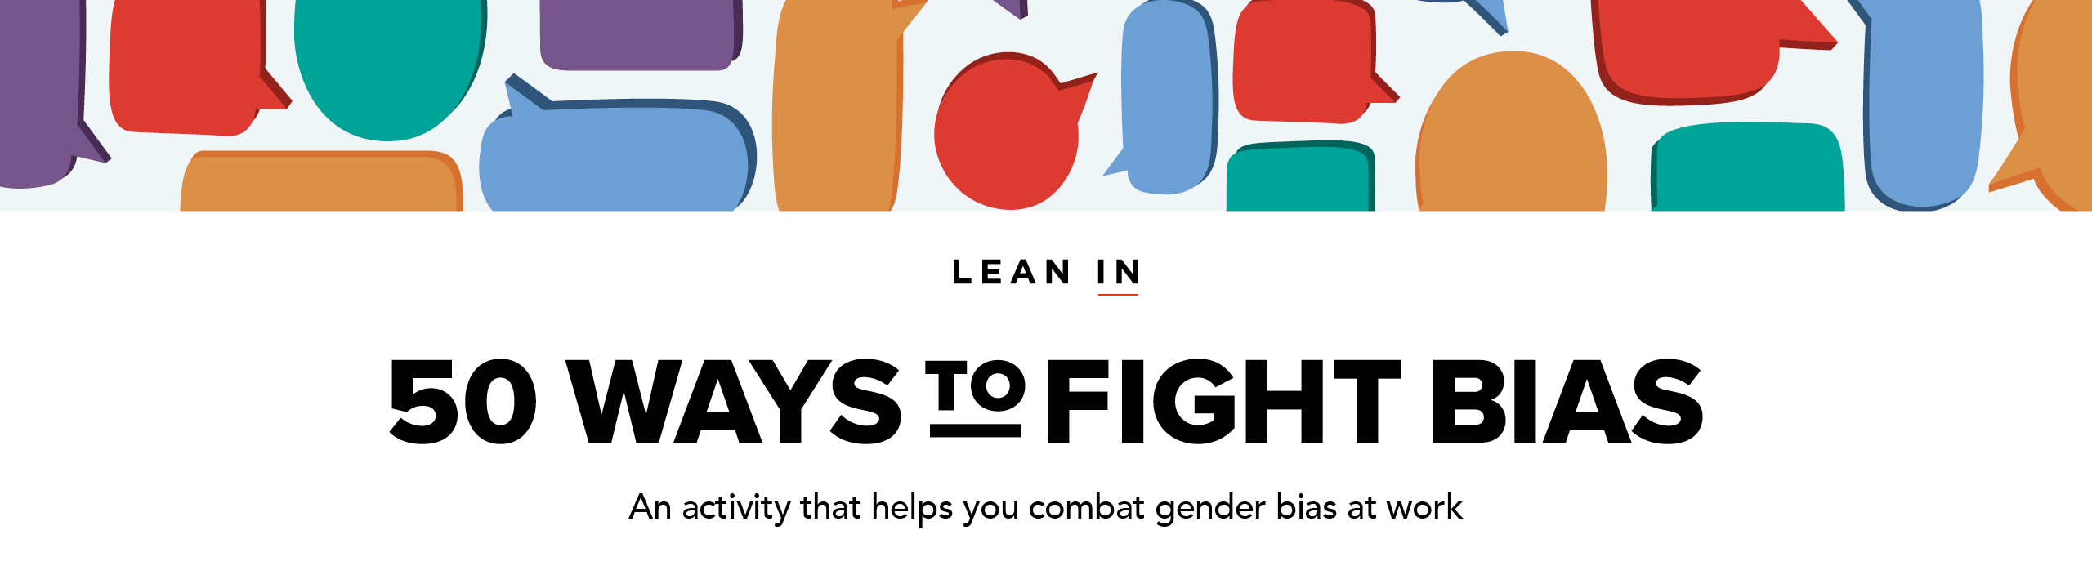
TO GET STARTED:
Download our Moderator Guide & Speaker Notes* to prepare for your session, find links to necessary handouts, and learn what to say.
ABOUT THE 50 WAYS PRESENTATION:
The 50 Ways to Fight Bias activity is divided into 4 different presentations.
Each presentation takes roughly 1–2 hours to complete and includes 12–13 different examples of gender bias in the workplace.
You can repeat this activity up to 4 times without repeating the same content.
This is PRESENTATION 4 of 4. For additional presentations, see the Moderator Guide & Speaker Notes.
* Use “Slide Show” mode to click on links in this presentation or right click to access the hyperlink when not in “Slide Show” mode.

Slide 3
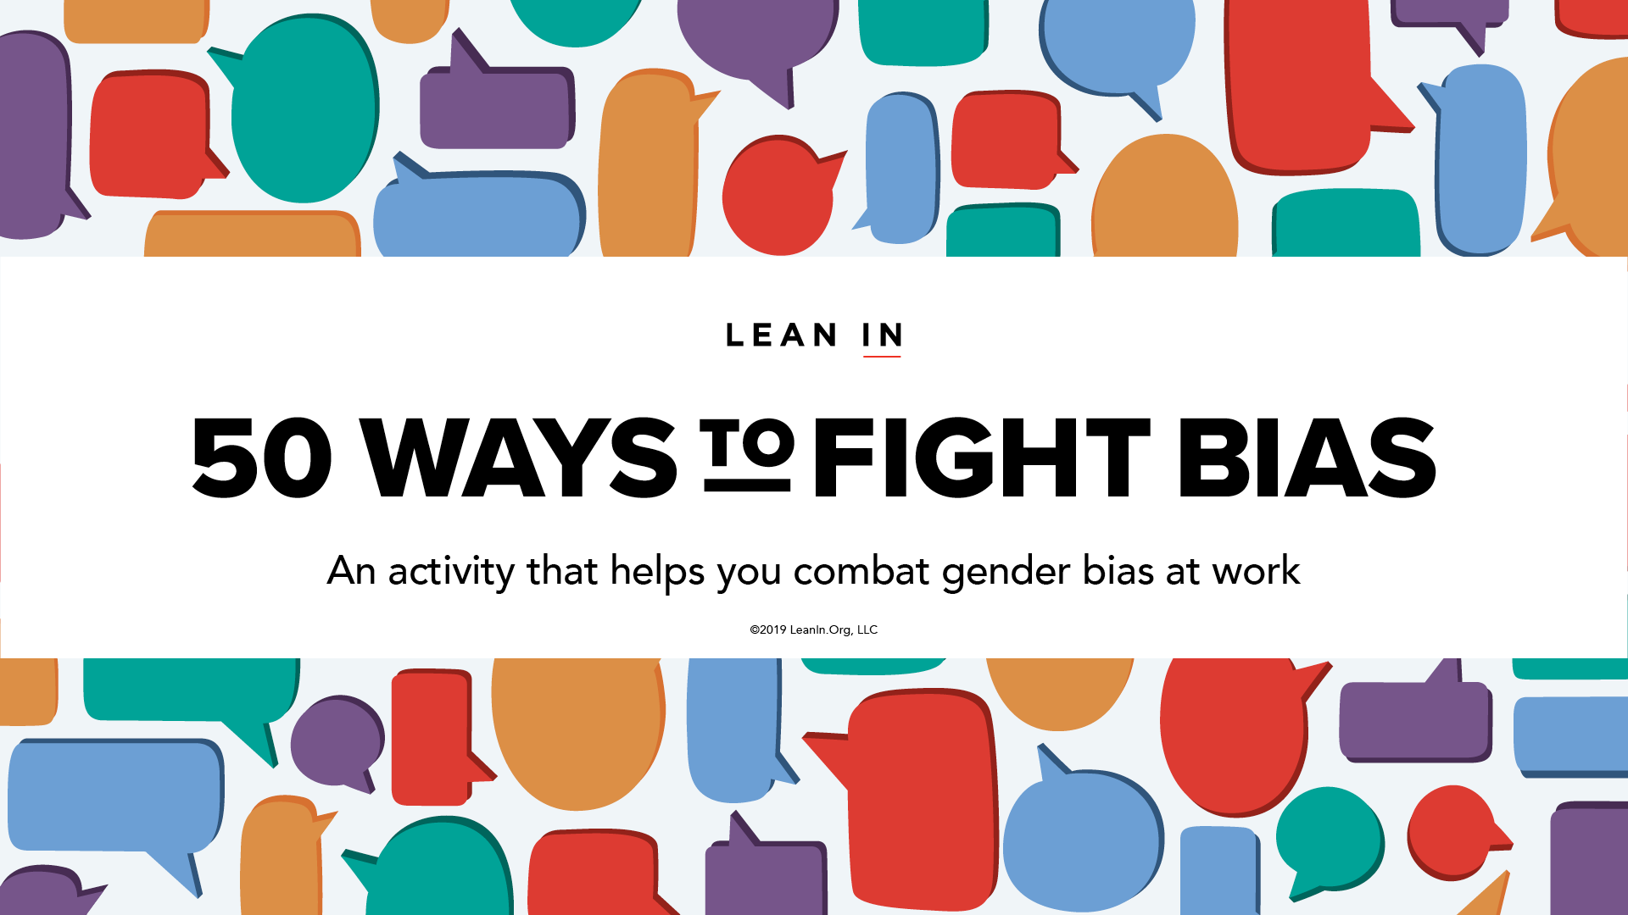

Slide 11
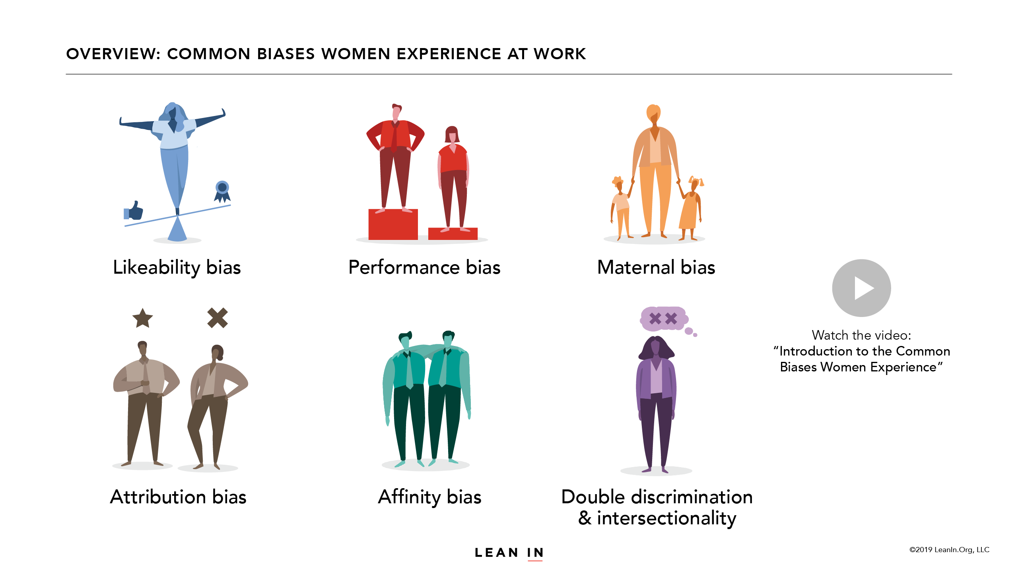
Watch the video: “Introduction to the Common Biases Women Experience”

Slide 22
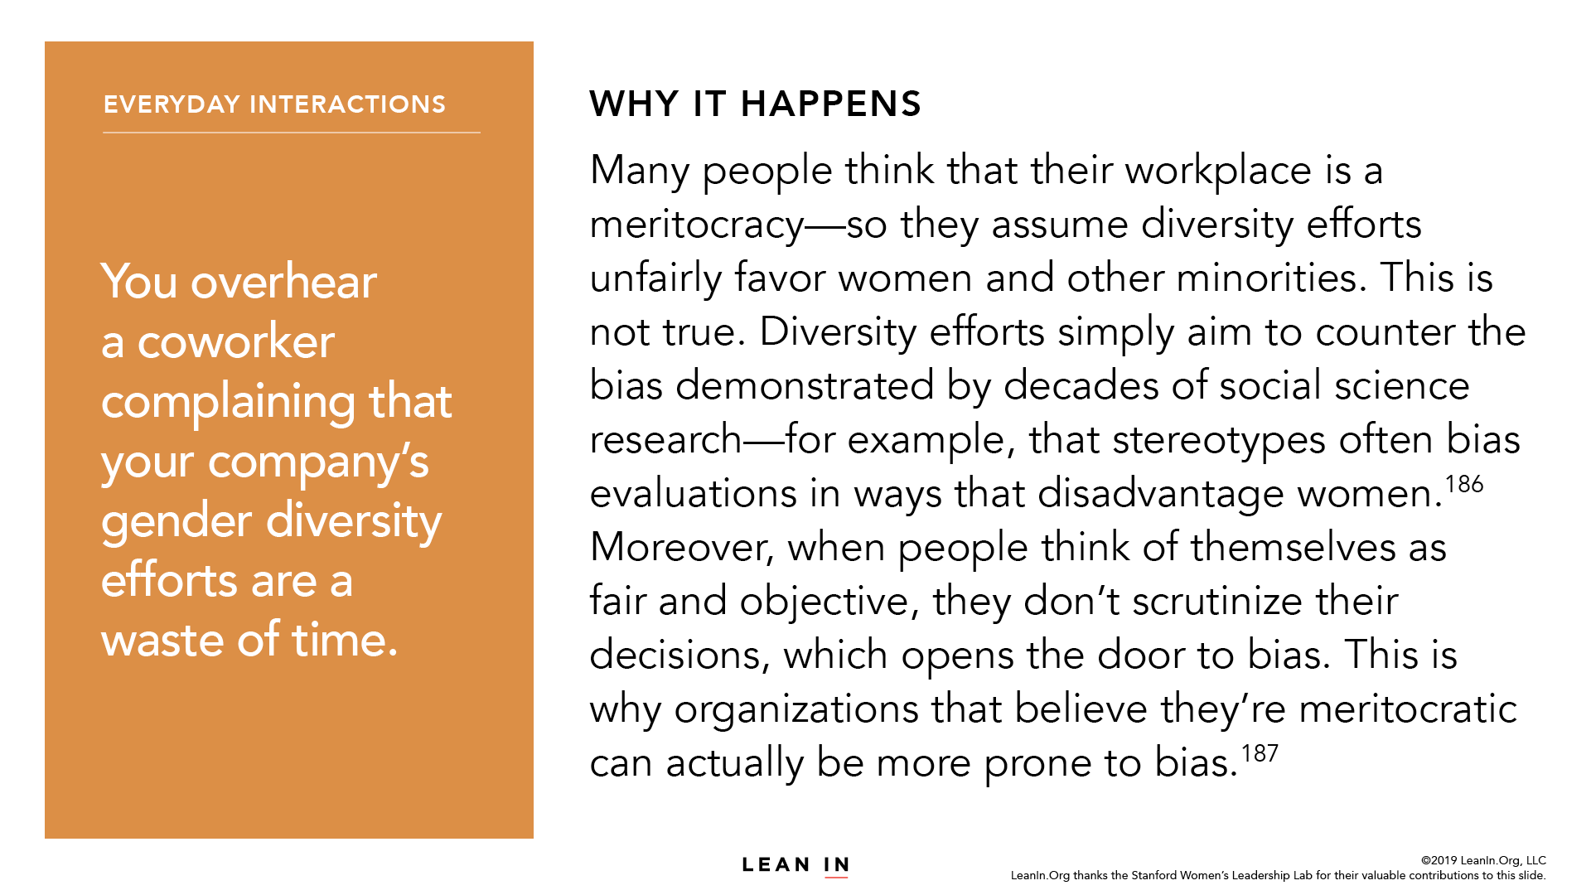

Slide 25
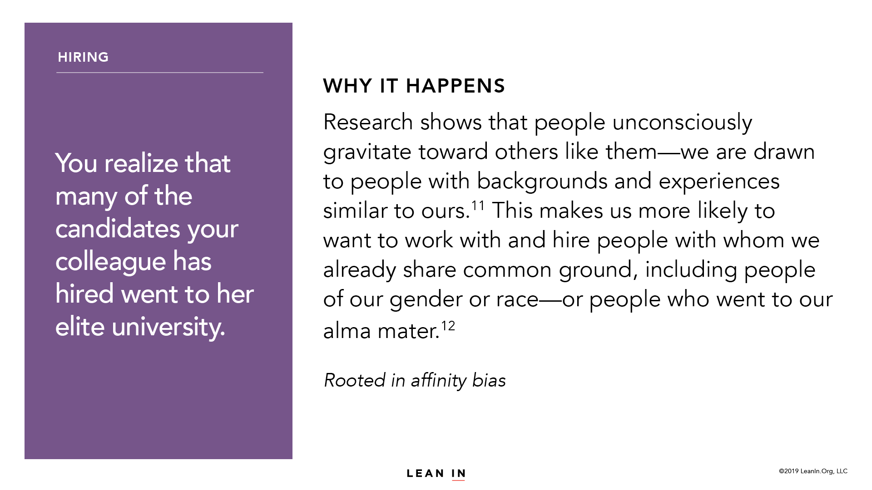

Slide 26
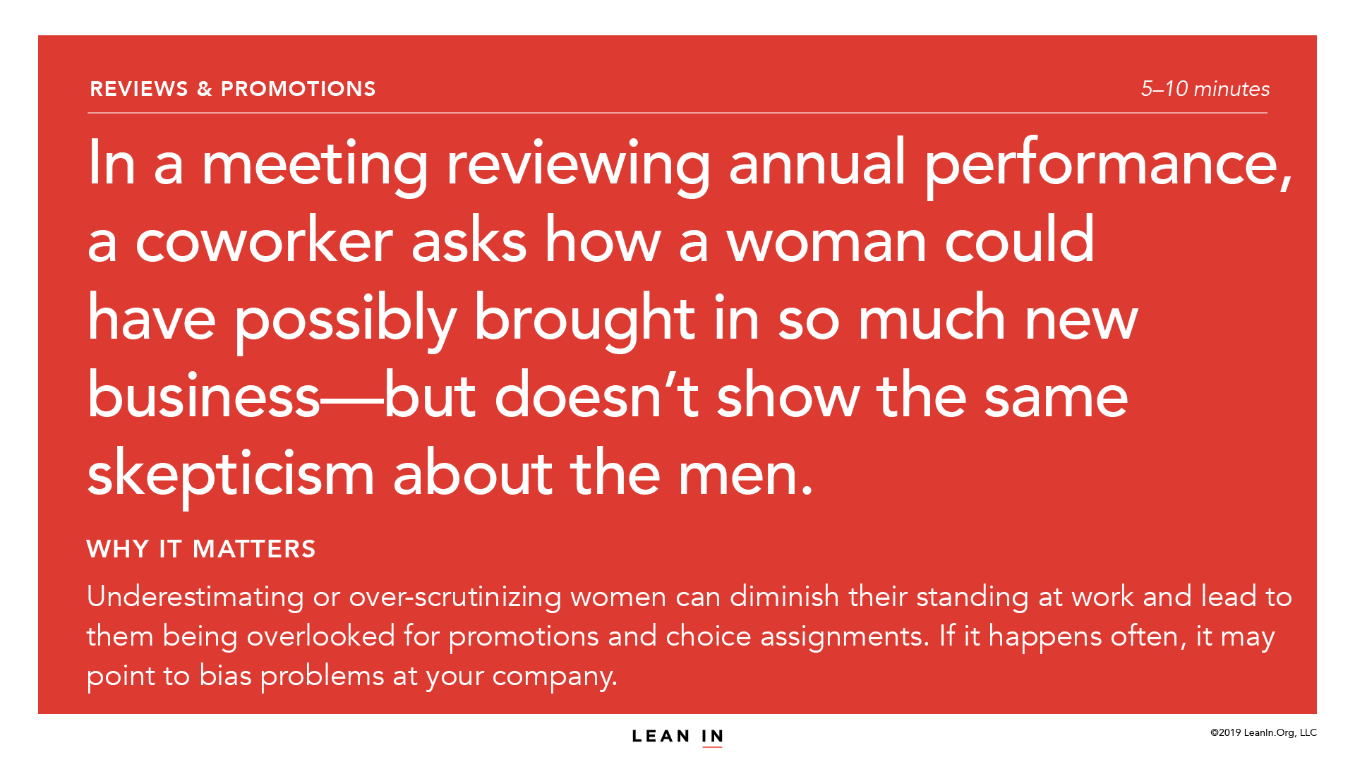

Slide 27
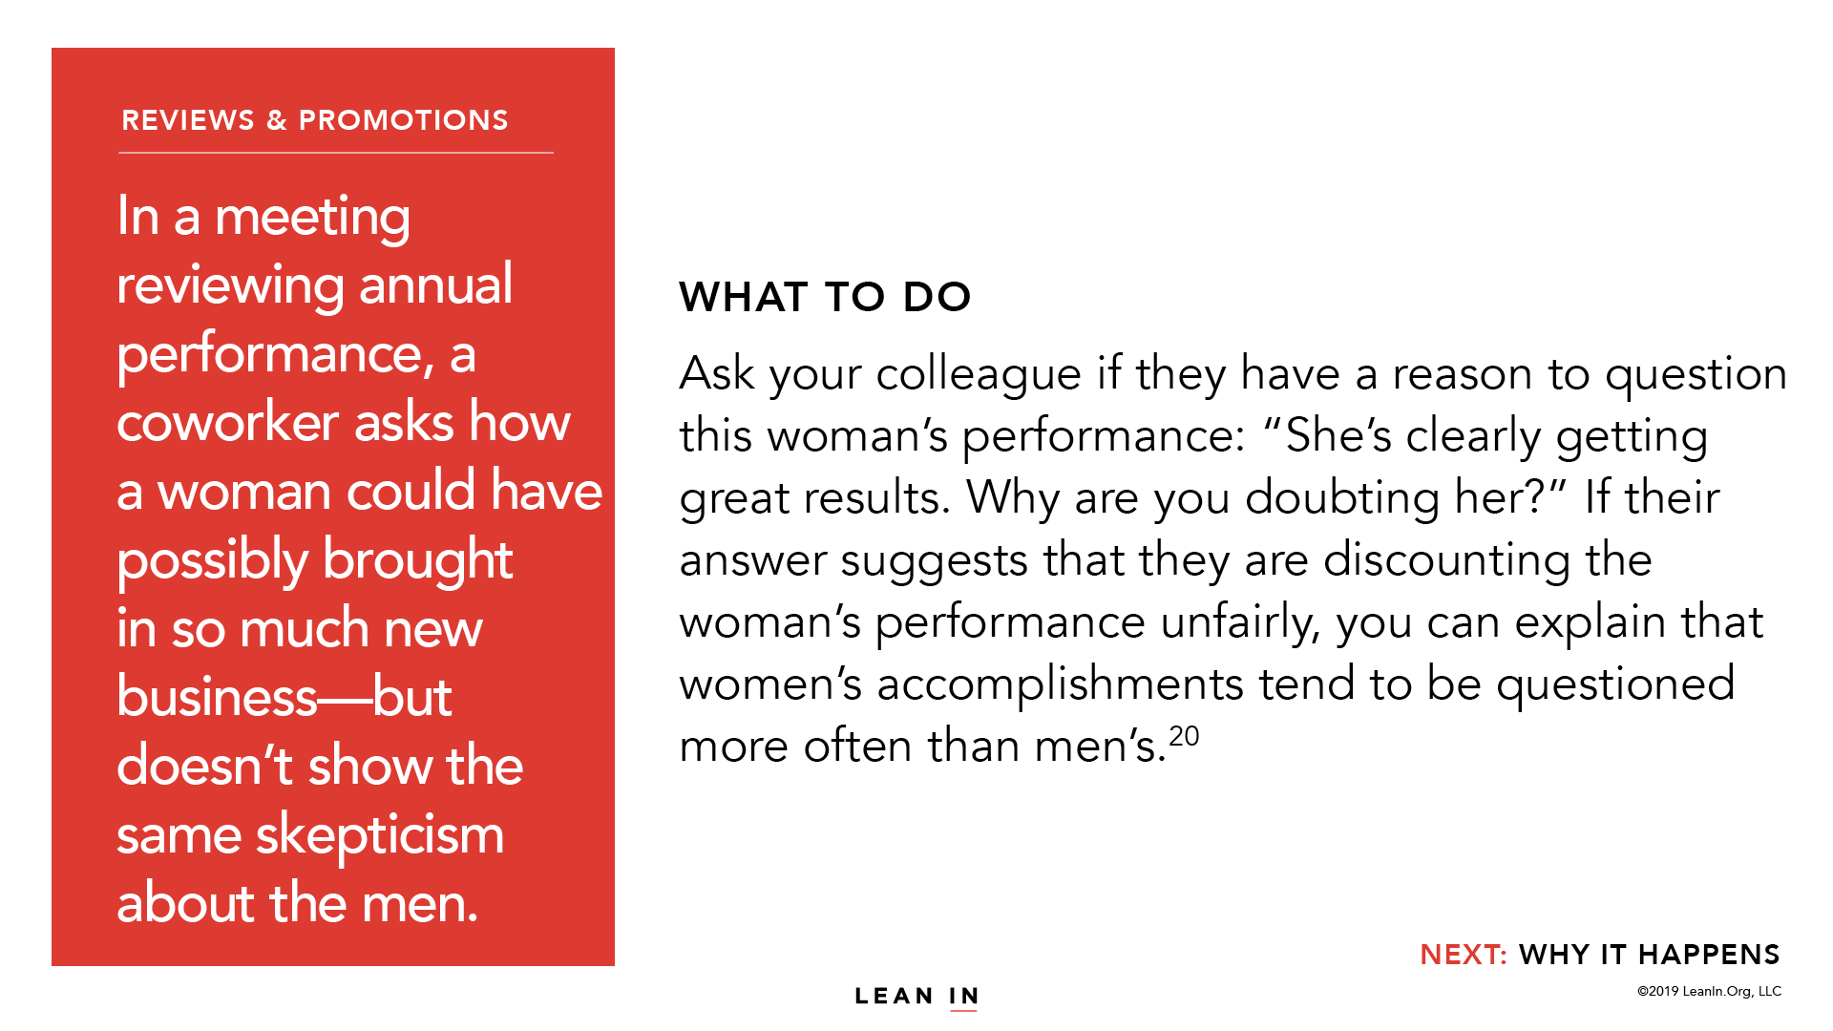

Slide 28
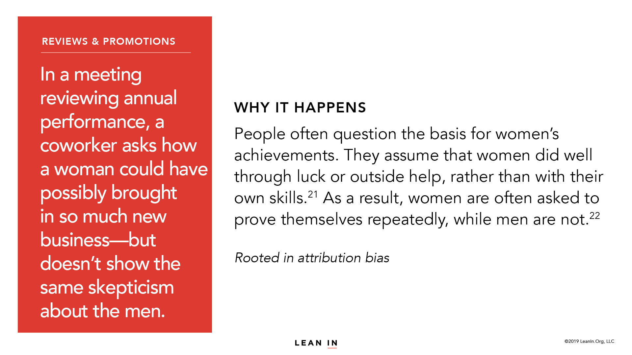

Slide 29
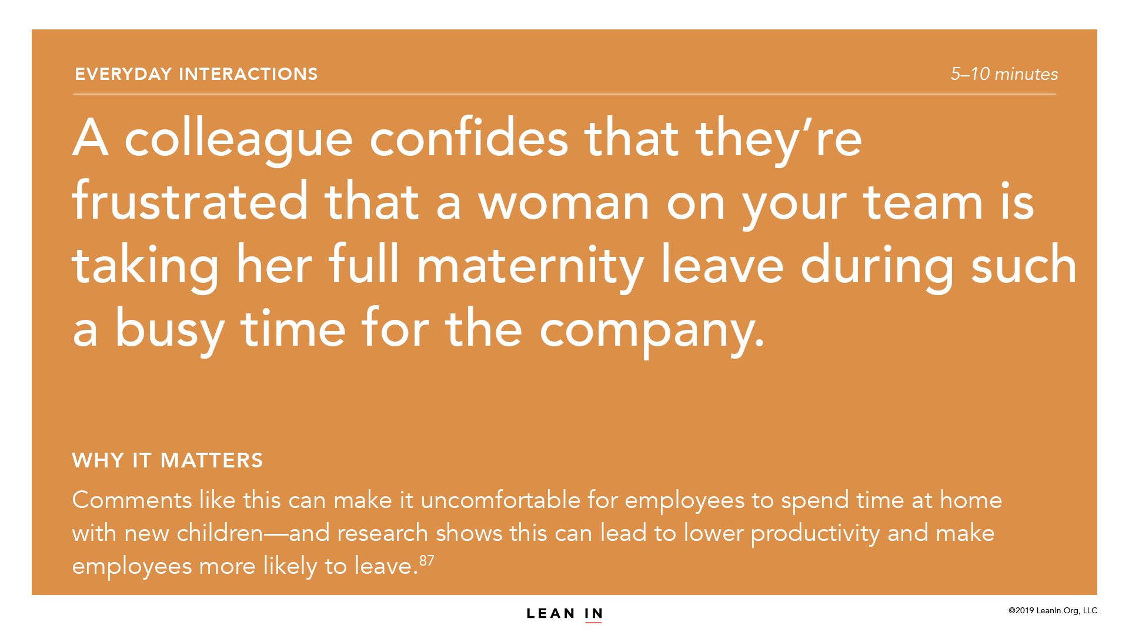

Slide 34
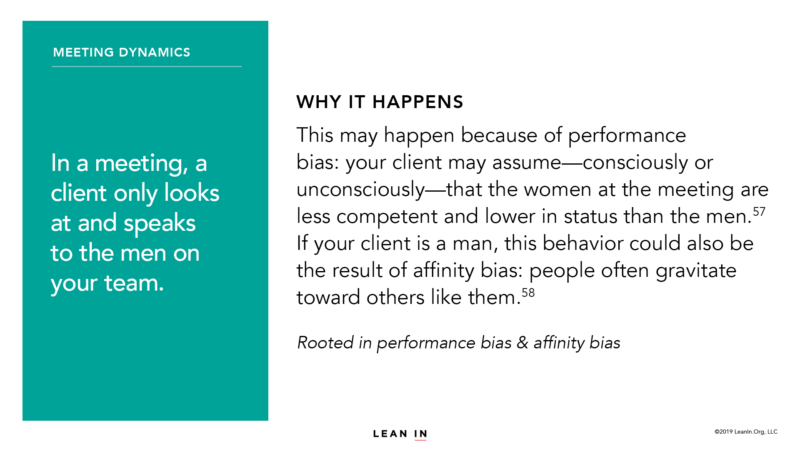

Slide 40
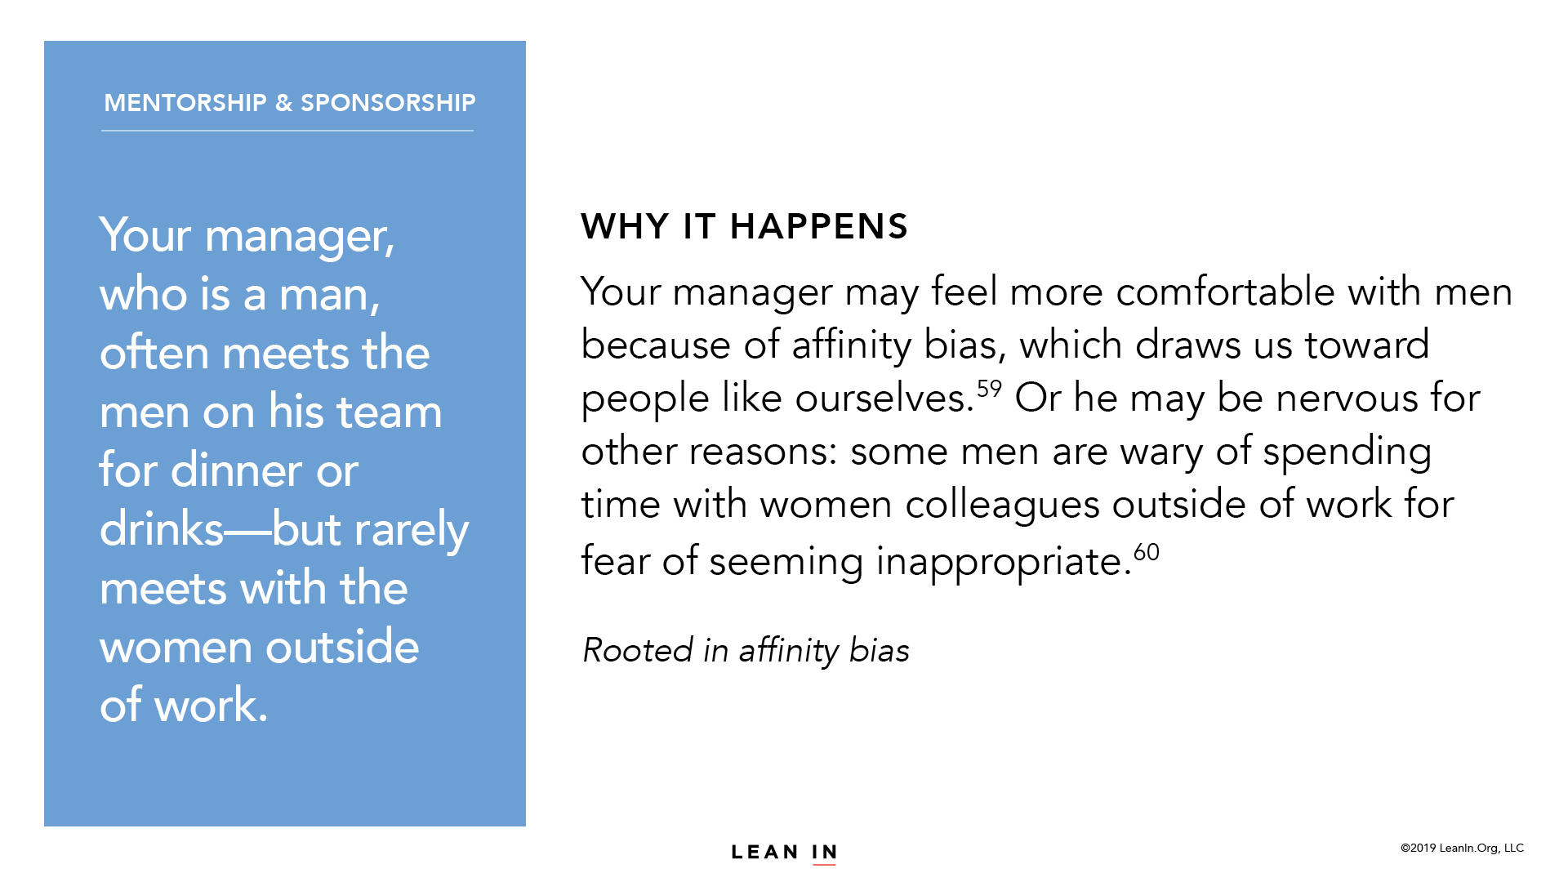

Slide 43
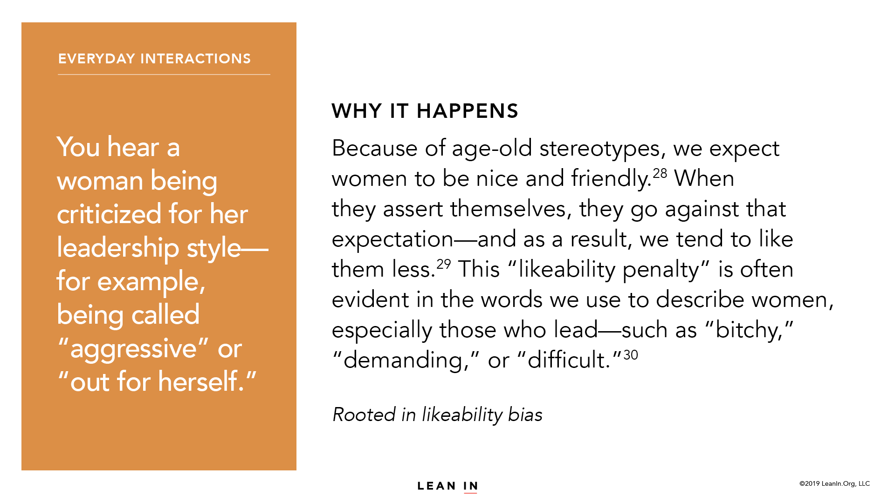

Slide 44
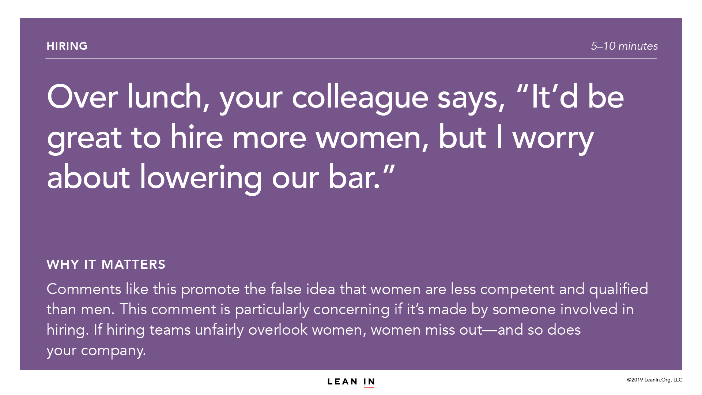

Slide 46
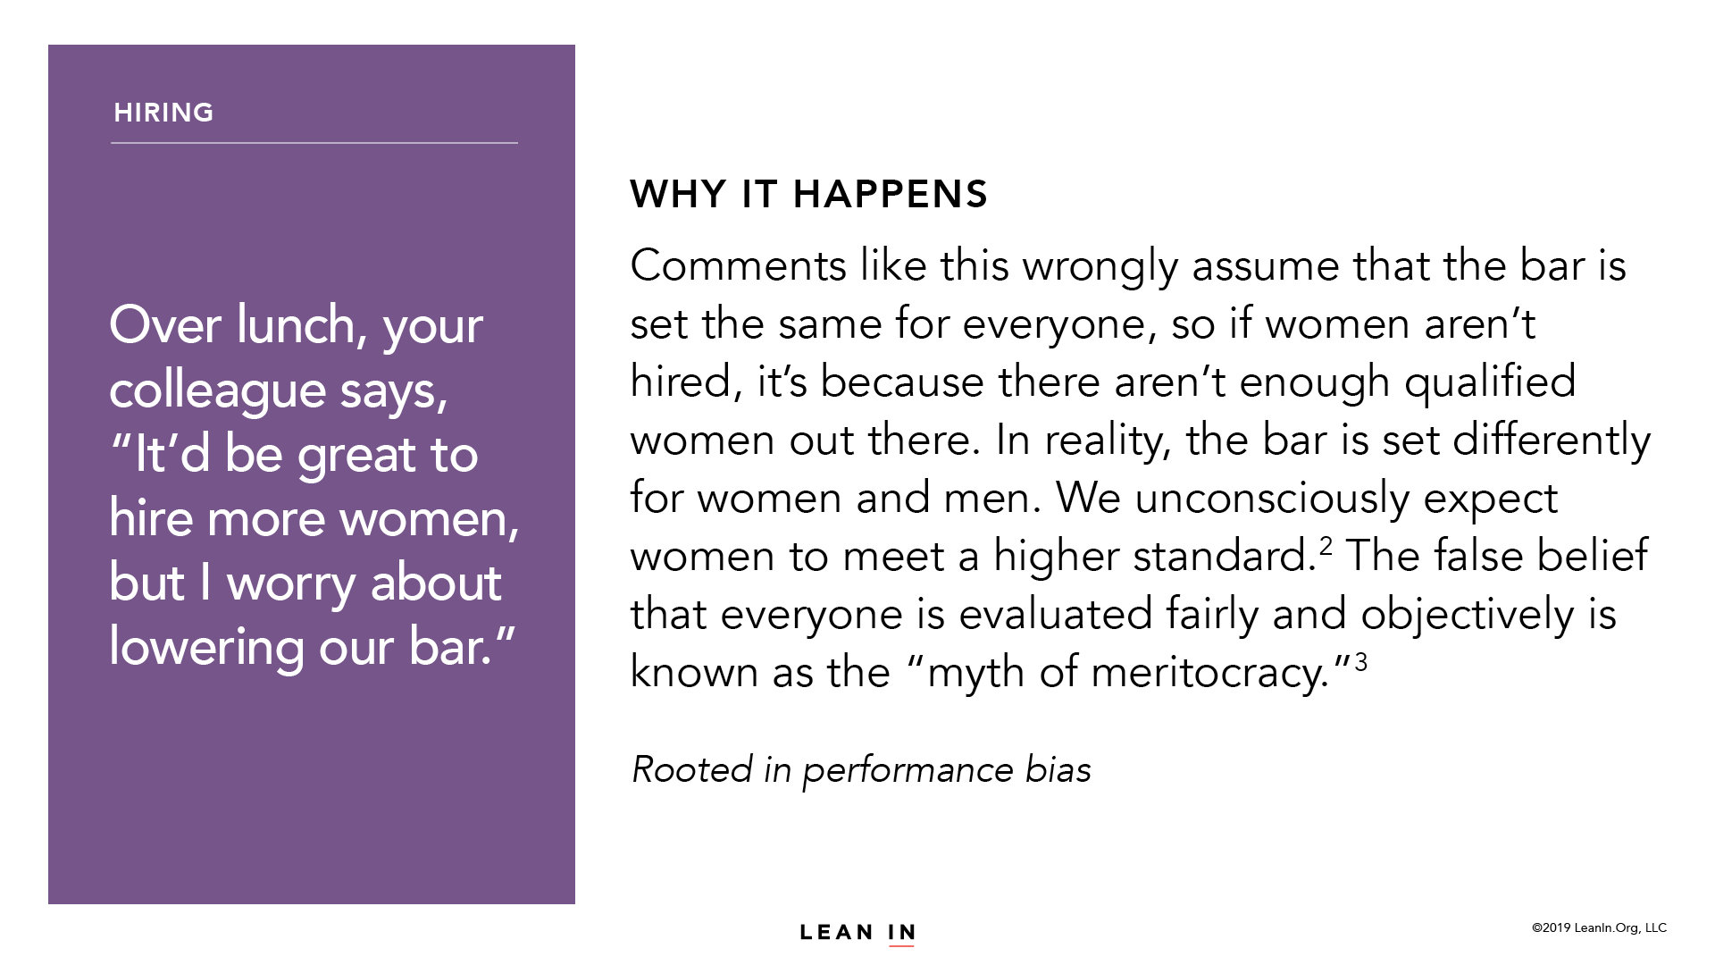

Slide 58
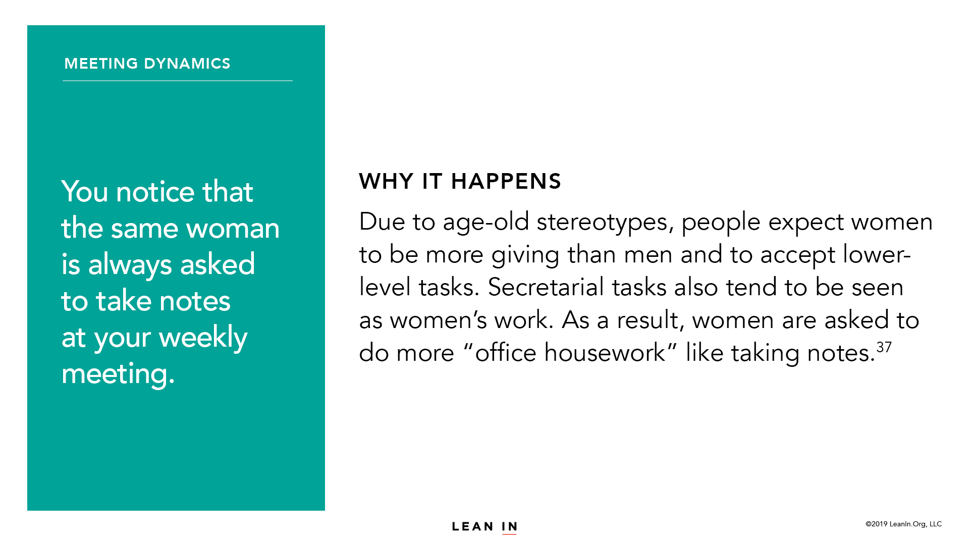

Slide 61
LEARN MORE AT
leanin.org

